Slide 1
NASA Nerds Spring 2020 Payload
Genevieve Cooper, Max Fell, David Rodriguez, Anyell Mata, Kyle McCormick, Feras Jayyusi

Slide 2
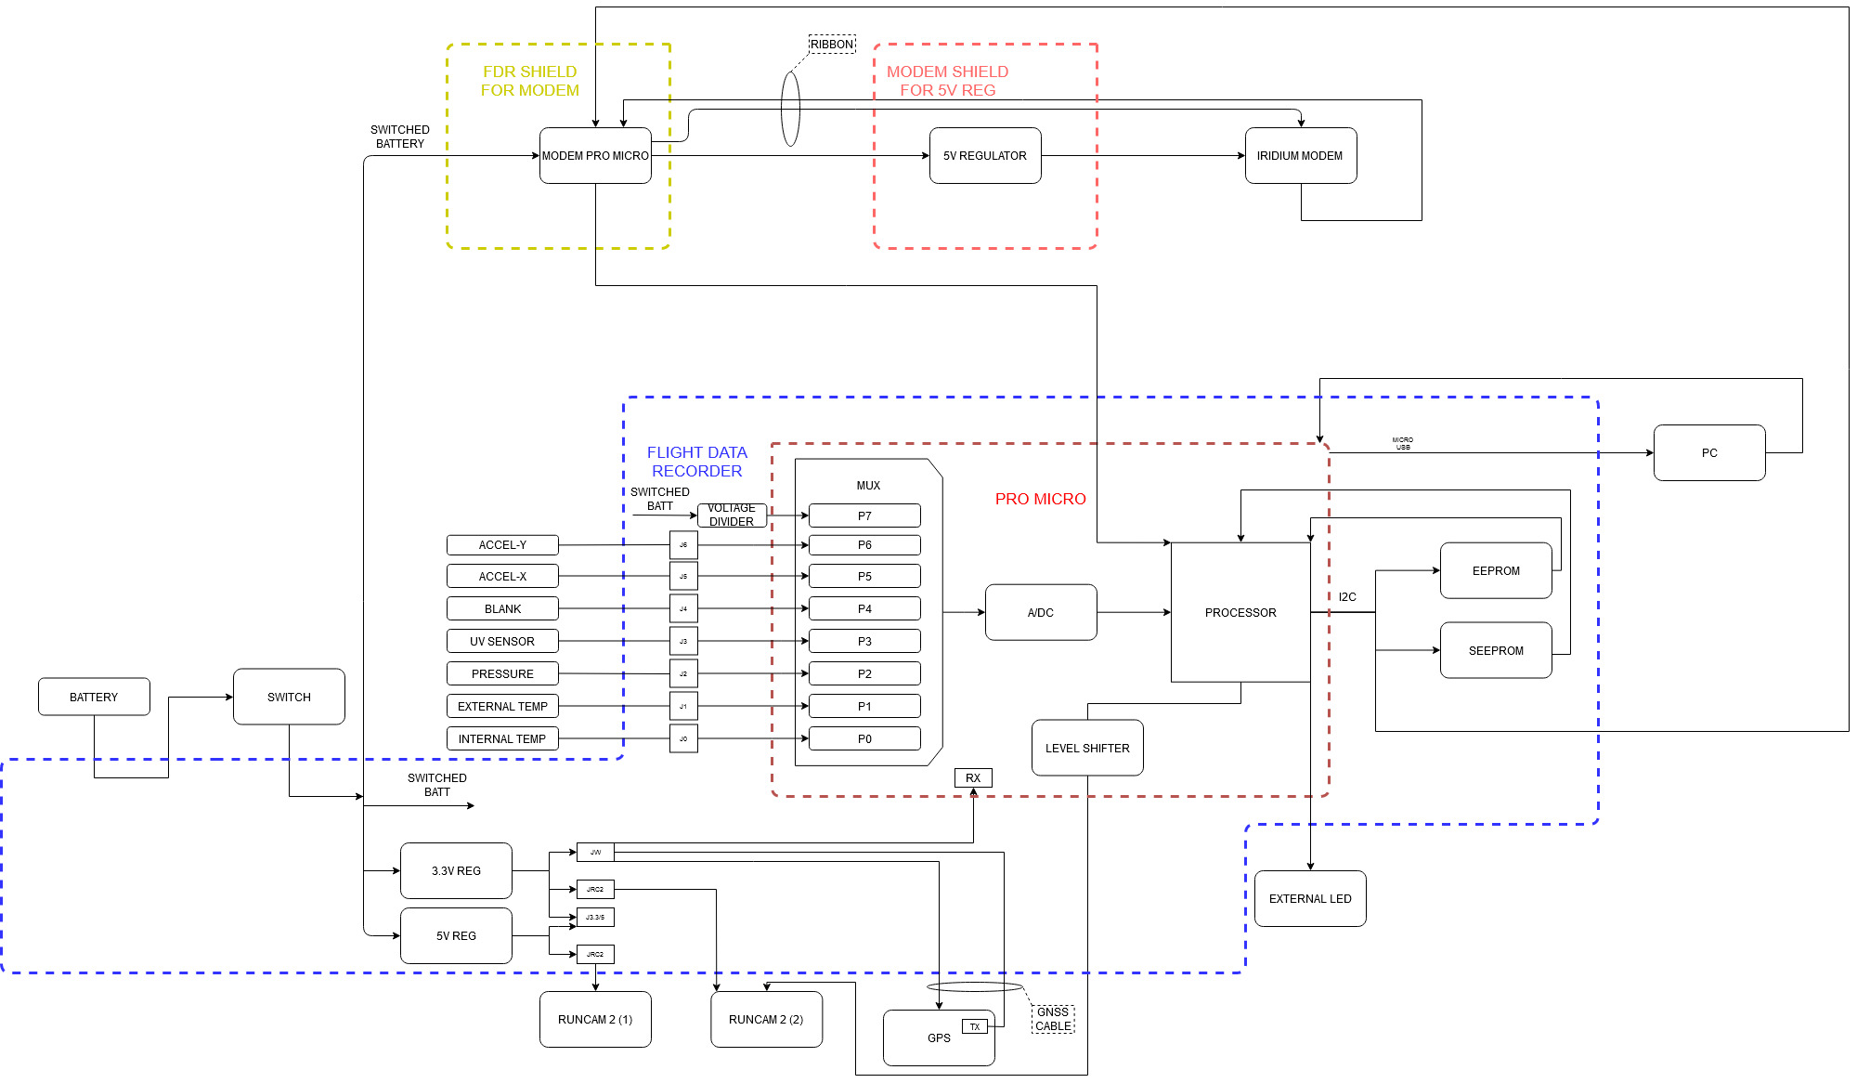
System Block Diagram

Slide 3
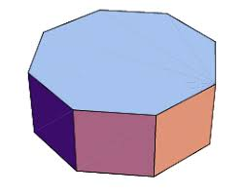
Payload Design
Shape of an octagonal prism
Symmetrical
8 sides to dedicate to individual components
Constructed with a single 20” X 30” Styrofoam sheet
Biggest issue: Accommodating for tolerance in styrofoam folds
Weight: 1.5 lbs (Including all components)
Volume:~370 in3
Opens on one of the octagon faces

Slide 4
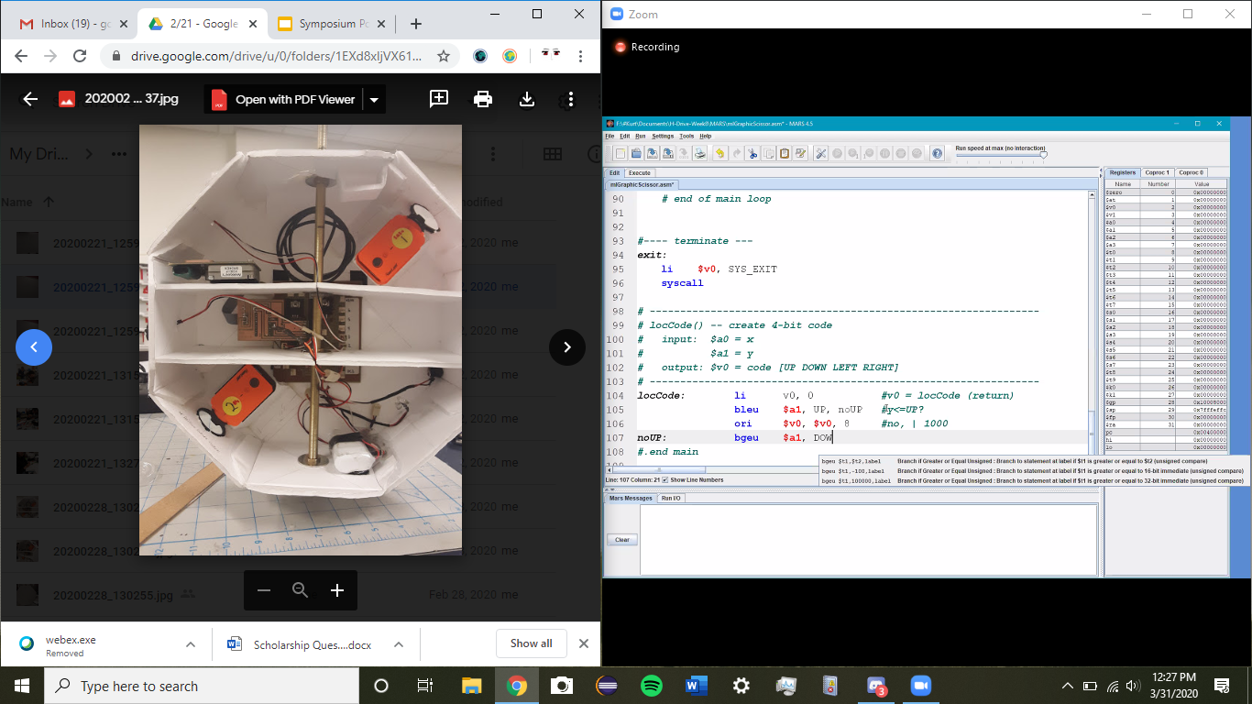
Payload Design
Balanced design
Flight Data Recorder placed in center
The Iridium Modem and GNSS must face the sky without obstructions
UV and external temperature sensor should be outside the payload
Shelves to separate components
Distributes heat evenly

Slide 5
Sensors and Components Overview
Arduino ProMicro Processor
TMP-36 Temperature Sensors (2)
DE-ACCMG Accelerometer
ASDX015 Pressure Sensor
RunCam2 Camera
UV Sensor
7.4V Lithium Ion Battery
Iridium Modem
GNSS (Global Network Satellite System)

Slide 6
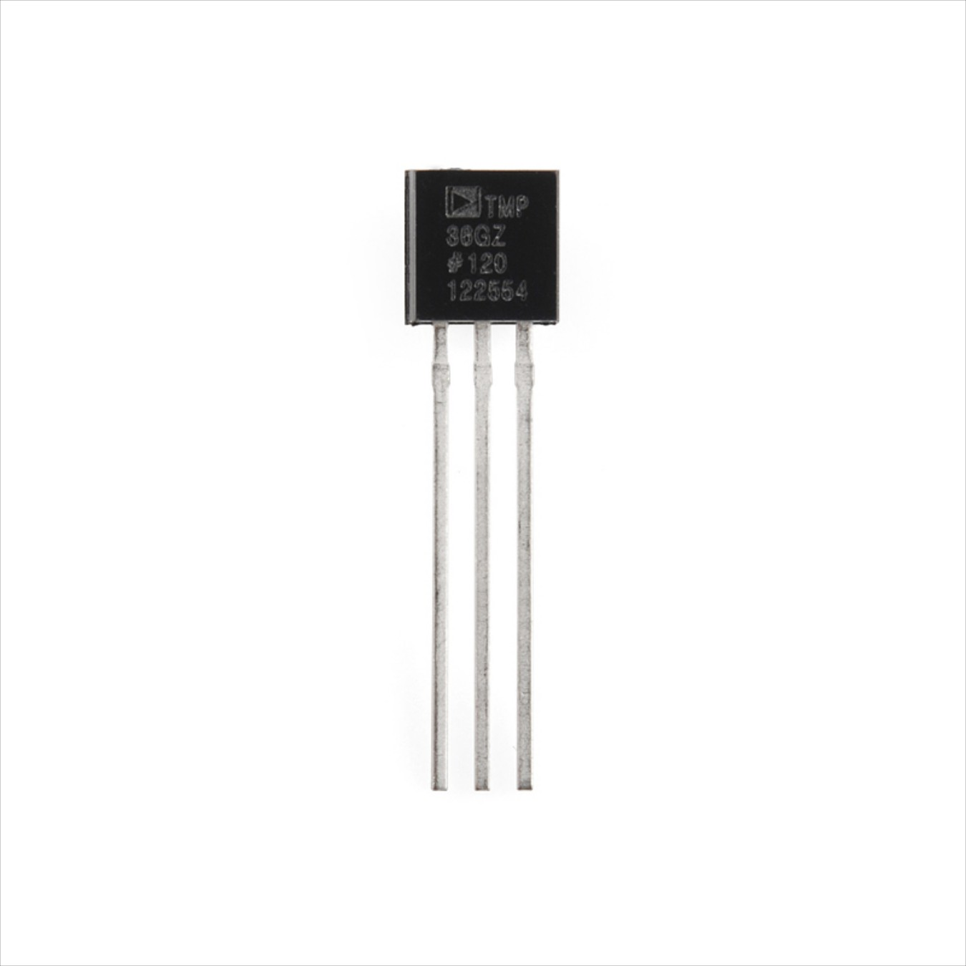
Temperature
2 TMP36 Sensors
Low voltage operation (2.7V - 5.5V)
Supply Voltage: 5V
Operating Temperature Range: -55℃ - +150℃
Calibrated in Celsius

Slide 7
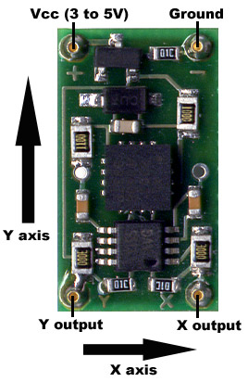
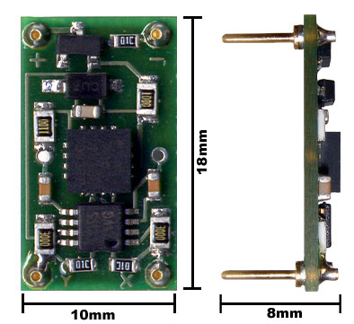
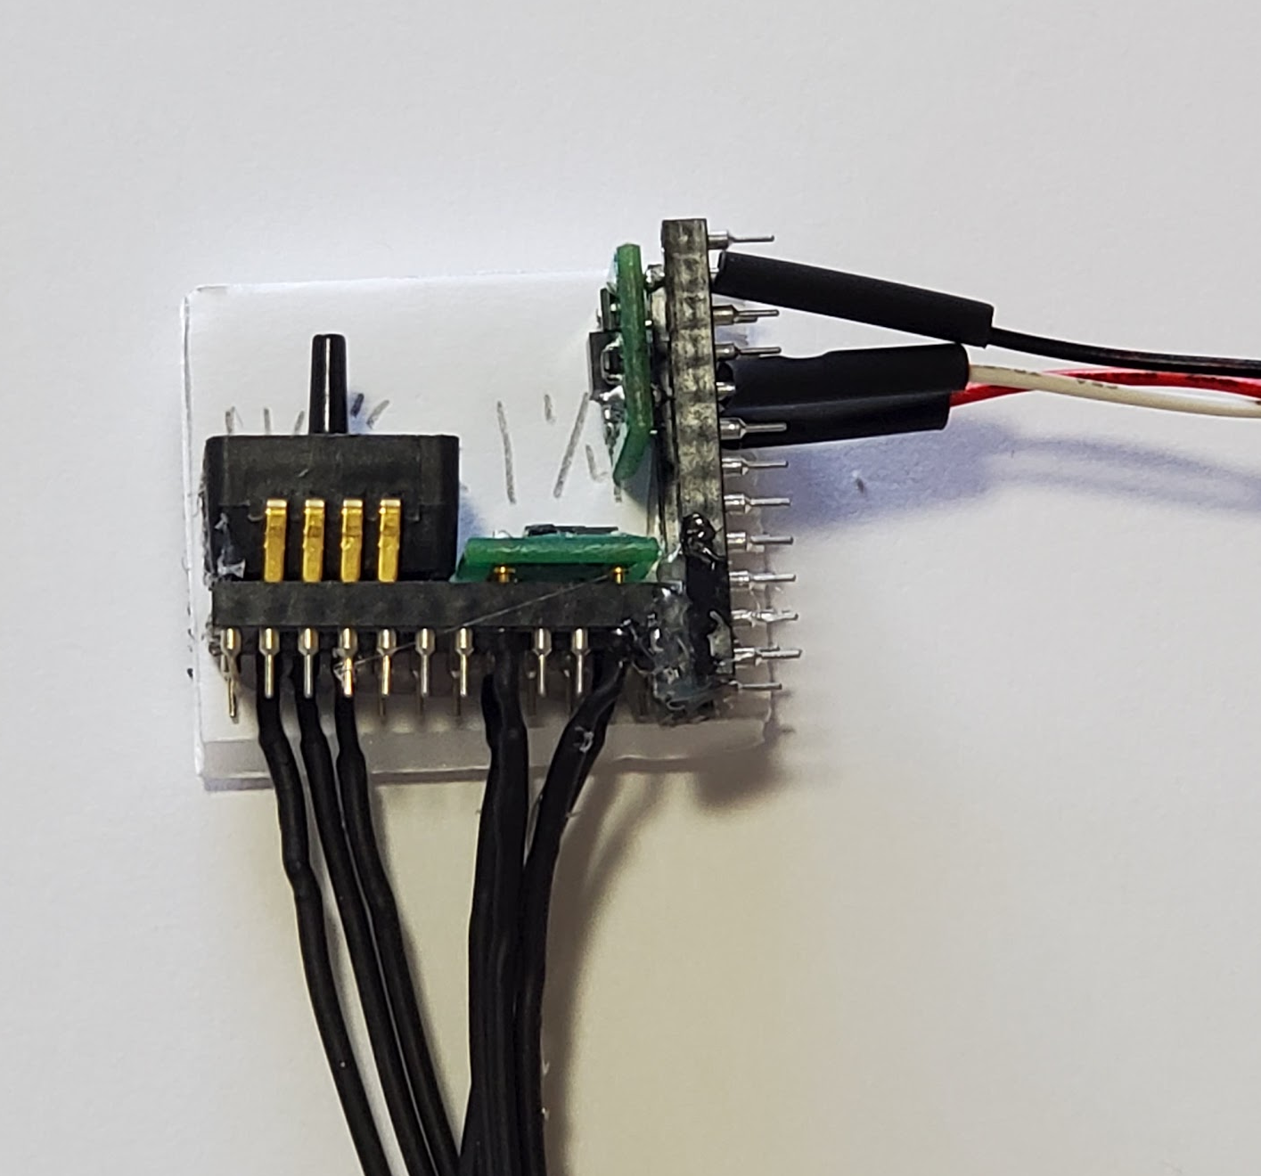
Accelerometer
(2) DE-ACCM6G
Each sensor limited to 2-axes
Can measure up to ∓6 g
Measures acceleration and orientation
0g = ~1.66v
Analog output is proprotional to acceleration

Slide 8
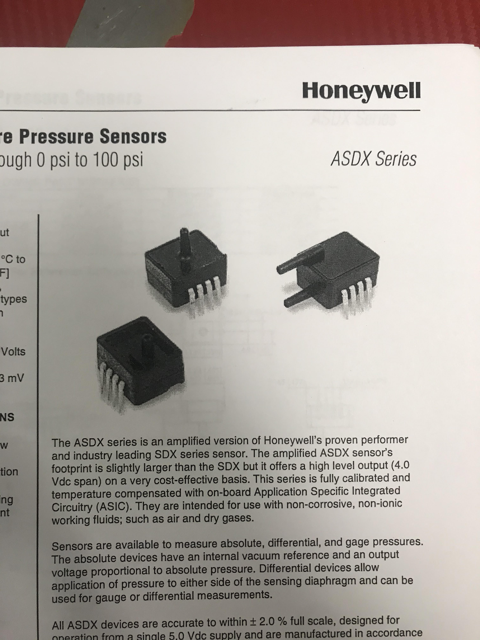
Pressure
Measures the change in pressure
Measures from 0-100psi
ASDX100 Model
∓2 % error

Slide 9
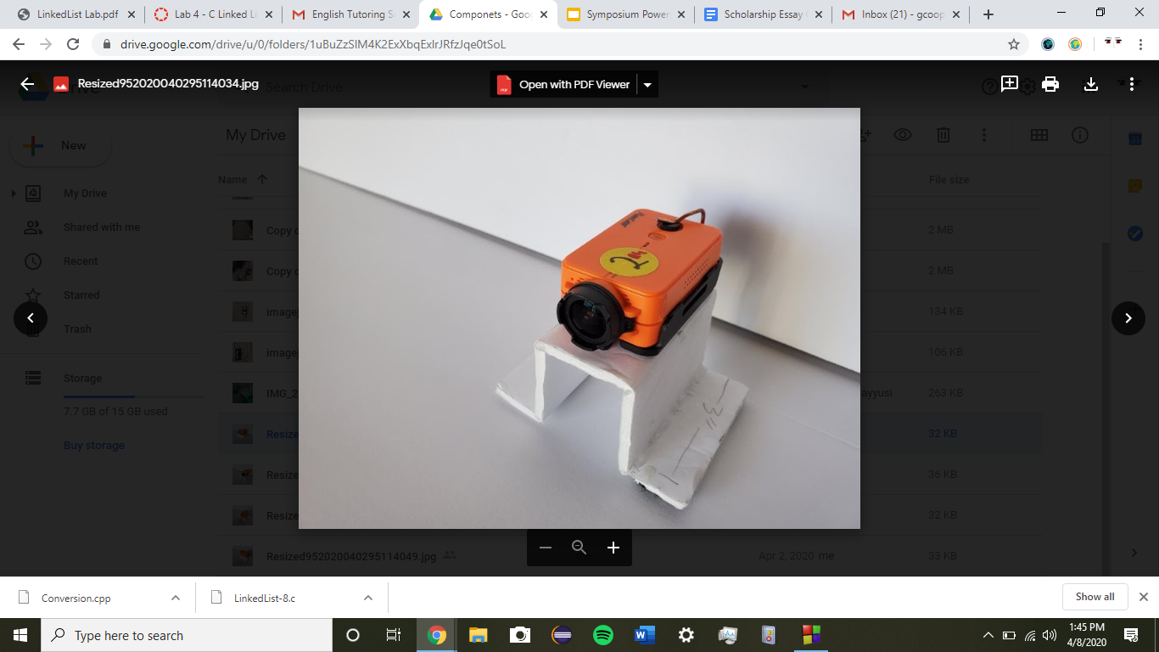
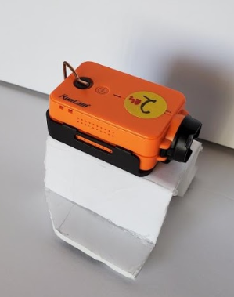
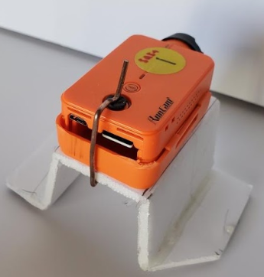
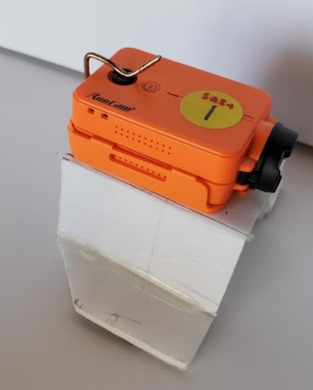
Cameras
2 RunCam 2
1 Completely controlled by arduino
Using Image Stabilization (IS)
1 Connected to power and ground ONLY
Displaying Time-Stamp
Homemade clamps using mousetrap arms
Propped up with tophat foam
Images/video accessible via MicroSD or App
Saves videos every 17 min
Needs 6V and produces heat

Slide 10
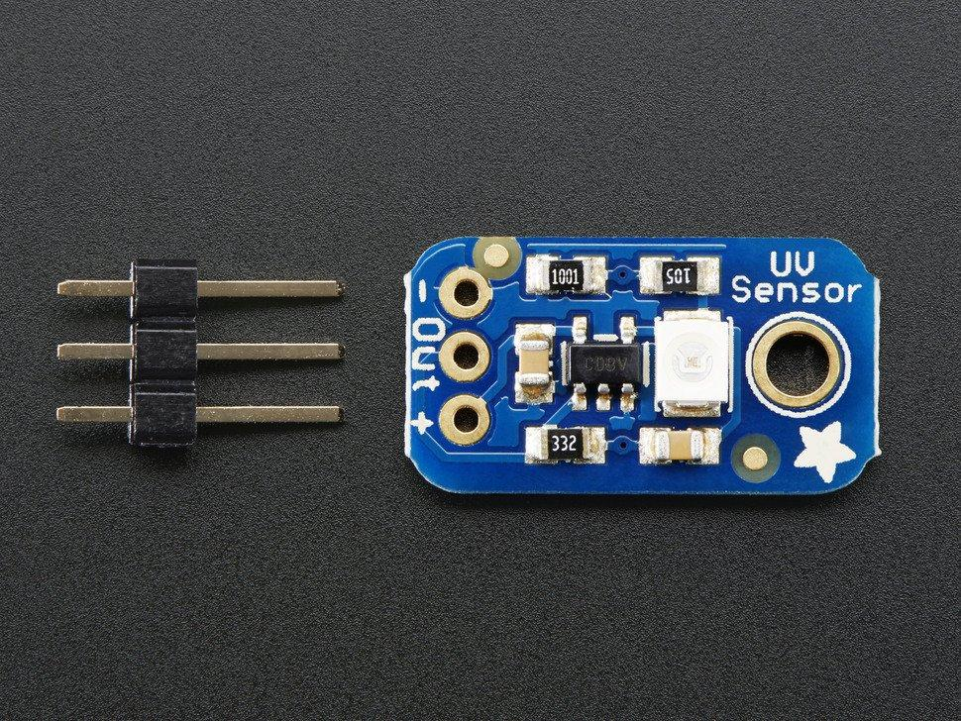
Ultraviolet
Adafruit UV Breakout 1918
Uses GUVA-S12SD photodiode
Detects 240-370nm range of light which covers UVB & most of UVA
Analogue sensor easily integrates with flight data recorder

Slide 11
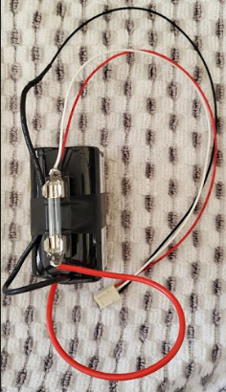
Battery
7.4V lithium ion battery
Has a fuse
4400mAh
Weight: 200g
Four 3.7 cells

Slide 12
Software Overview
Purpose of the Arduino Software was to be able to keep track of all the data and allow our sensors to function properly
To access our code, we use the Arduino IDE (this is how we programmed the GNSS and Iridium Modem)
We used a software called Tera Term to access our Flight Data Recorders menu/interface.

Slide 13
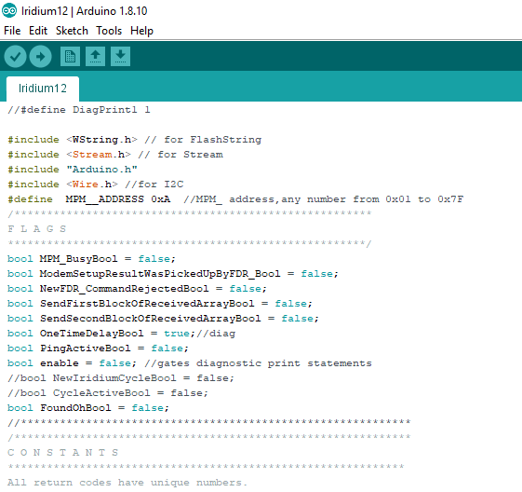
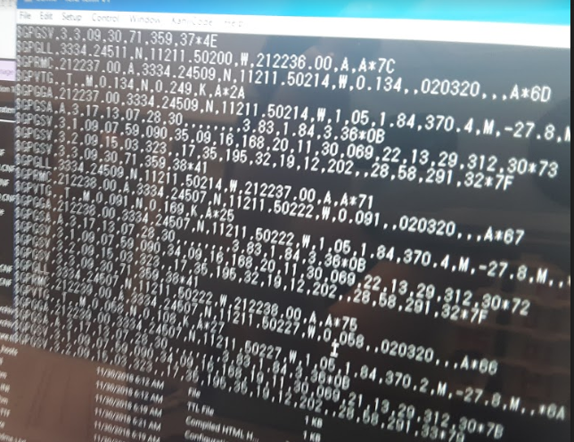
Software Overview
Arduino
Tera Term

Slide 14
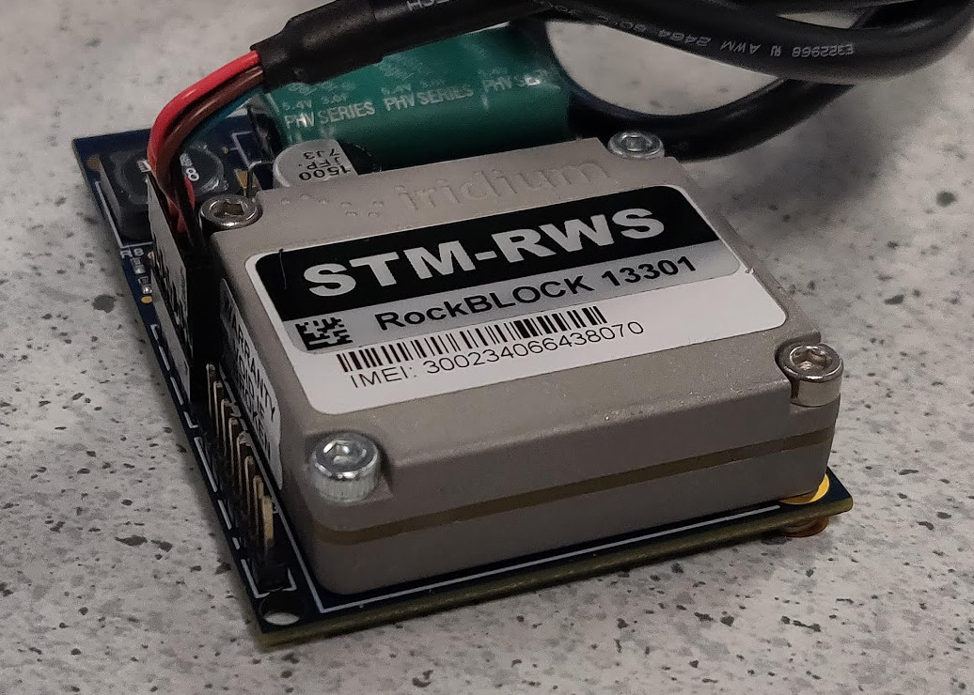
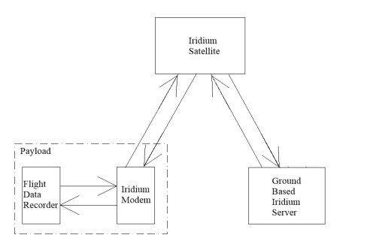
Iridium Modem
A single modem inside payload
Communicated with iridium satellites
Capable of sending 45 bytes of data at a time
Data sent from modem to an iridium satellite, which then communicates with a ground based server
Server then sends out emails to an account setup by the user

Slide 15
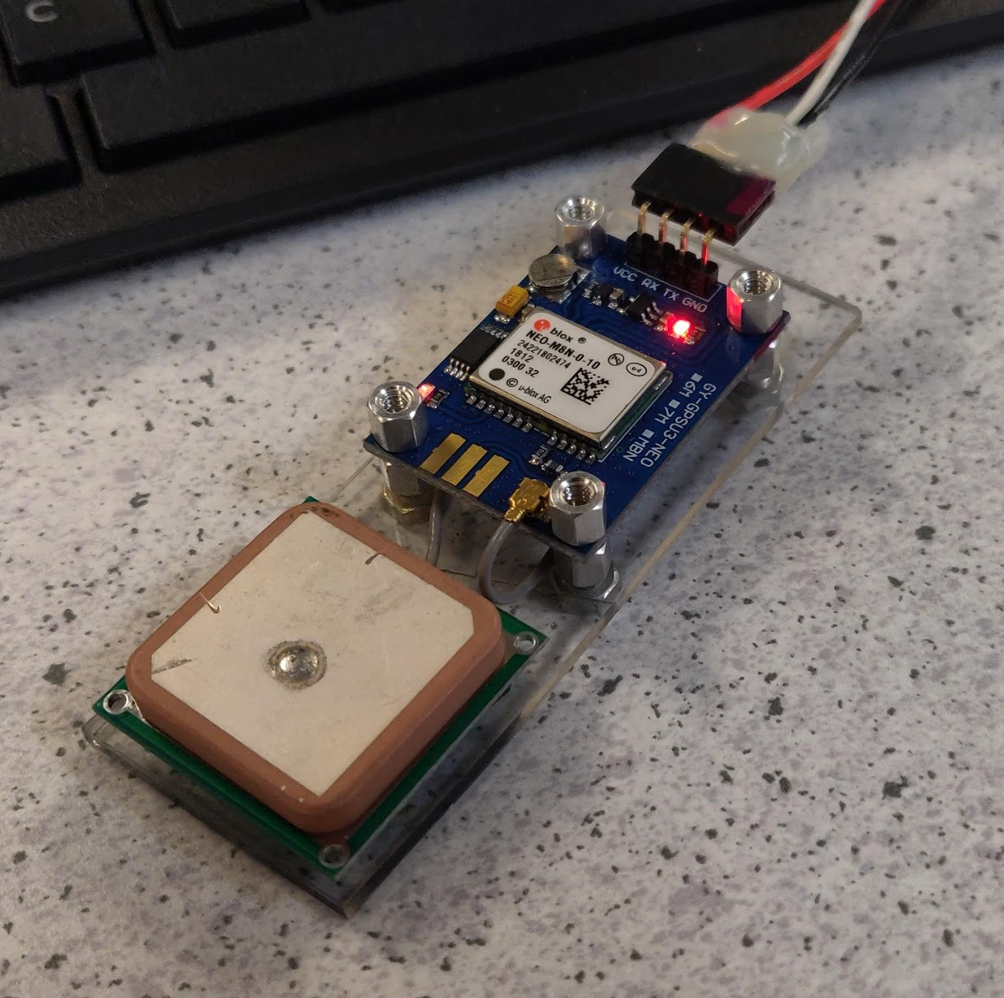
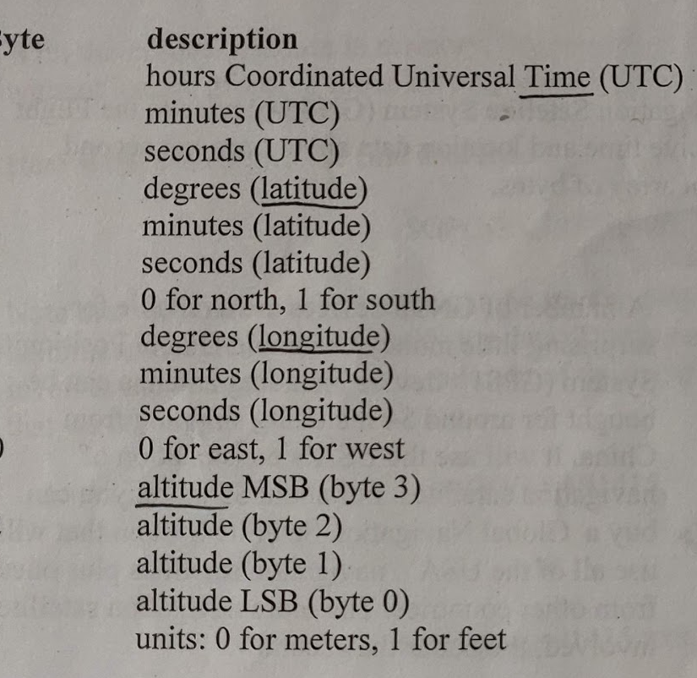
GNSS
Global Network Satellite System
GNSS data would be compared with ANSR’s GPS data
GNSS data returns a 16 byte array
The data received would then be entered into a mapping software such as Google Earth which would then show the location of the GNSS at the reported time

Slide 16
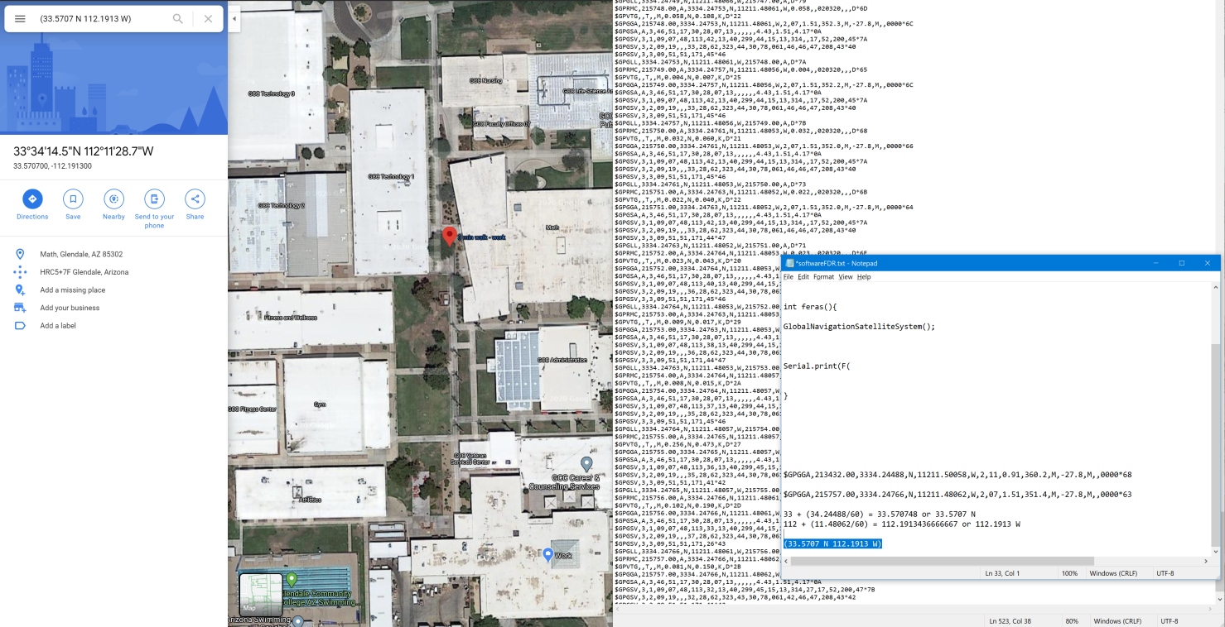

Slide 17
Special Thanks:
Dr. Timothy Frank
Rick Sparber
Wayne Smith
Arizona Near Space Research
NASA Space Grant
Thank you!
Check out our website: https://nasanerds.weebly.com/

